Slide 1
Energy ExpendIture EstImatIon
Baha Hakkı Demircioğlu
1409872

Slide 2
ENERGY EXPENDITURE PREDICTION
Target is predict the cosmed(energy expenditure measurement) depending on given variables.

Slide 3
Table of content
Why Do We Need It?
Who Can Use It?
Subjects of Data
The Data
Implementation
Conclusion

Slide 4
Why do we need ıt
Everyone spends energy, even though doing nothing. Energy Expanditure is the main calculation of a human’s energy spending, depending on many variables. With the understand of it we can understand the «health» and «live»s on mathematical way; think and make comment correctly.

Slide 5
Who can use
Hospitals
Teams
Wellness Centers-Companies
Anyone related or curious about human health

Slide 6
Subjects
A total of ten healthy participants: (age 27.2 years (SD = 3.1); BMI 24.1 kg/m-2 (SD = 2.3); weight 78.2 kg (SD = 10.9)) completed a two-week study (each participant was recorded during one day for approximately eight hours).

Slide 7
The data
Sensor Type
peakCount acceleration peak counts Shimmer Acc float
Z_breathRate breath rate Zephyr float
Z_hearthRate hearth rate Zephyr float
Z_skinTemp temperature from chest Zephyr float
SW_GSR galvanic skin response BodyMedia float
SW_NearBodyTemp near body ambient temperature BodyMedia float
SW_skinTemp temperature from arm BodyMedia float
pred_Activity what the subject done just yet string

Slide 8
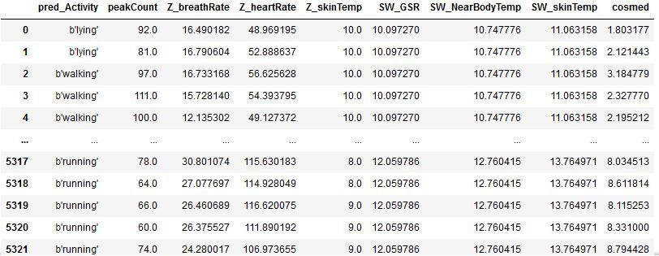
Understandıng the data

Slide 9
Understandıng the data (cont.)
As pred_Activity was not in numeric form, I had to deal with it, after it’s done I was able to apply the regression algorithms.
In the project I divided data in 3 parts and used 1 of them for testing (%33).

Slide 10
Implementatıon
3 regression algorithms applied:
Linear Regression
Random Sample Consensus (RANSAC) (Robust)
Theil-Sen Estimator (Robust)

Slide 11
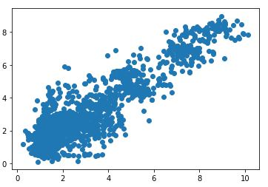
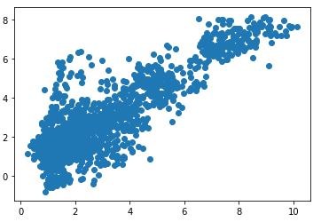
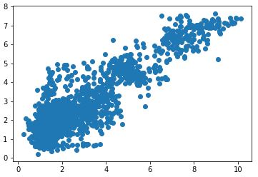
(Test Data, Linear) (Test Data, RANSAC) (Test Data, Theil-Sen)

Slide 12
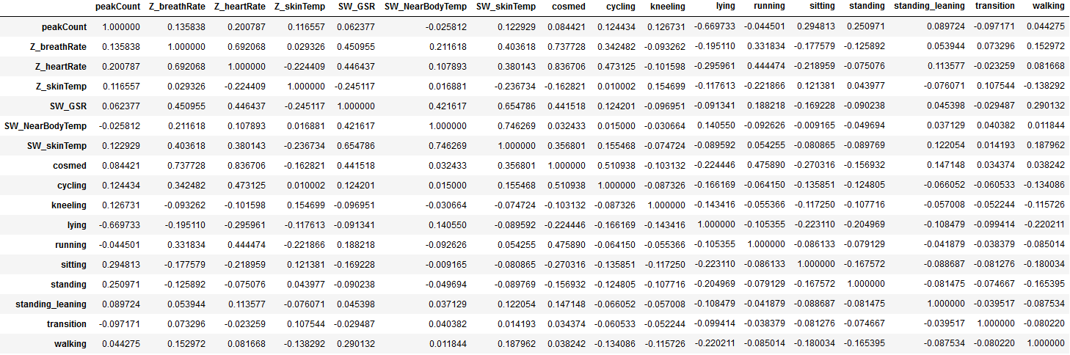
1:Right Proportion -1:Inverse Proportion

Slide 13
Conclusıon
R SQUARE SCORES:
Linear Regression: ~0.80
RANSAC: ~0.73
Theil-Sen: ~0.78
Linear Regression is the best fit for this case, for this project. Has a good rate with %33 testing. In this case BIG Data implementation is a great example of how a good job can be done with this tech.
(Much more data can be found in the project file.)

Slide 14
Conclusıon – for me
In this project I have;
done one hot encoding, due to existence of non numeric variables,
applied 3 regression algorithms,
compared results and see/show the differences,
understood manipulating and be a colleague the data.

